Slide 1
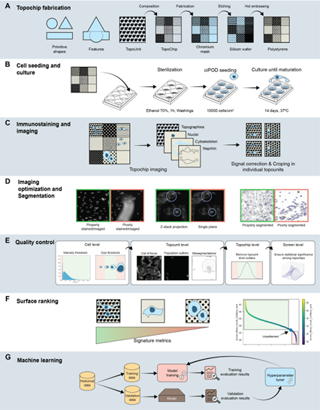

Slide 2
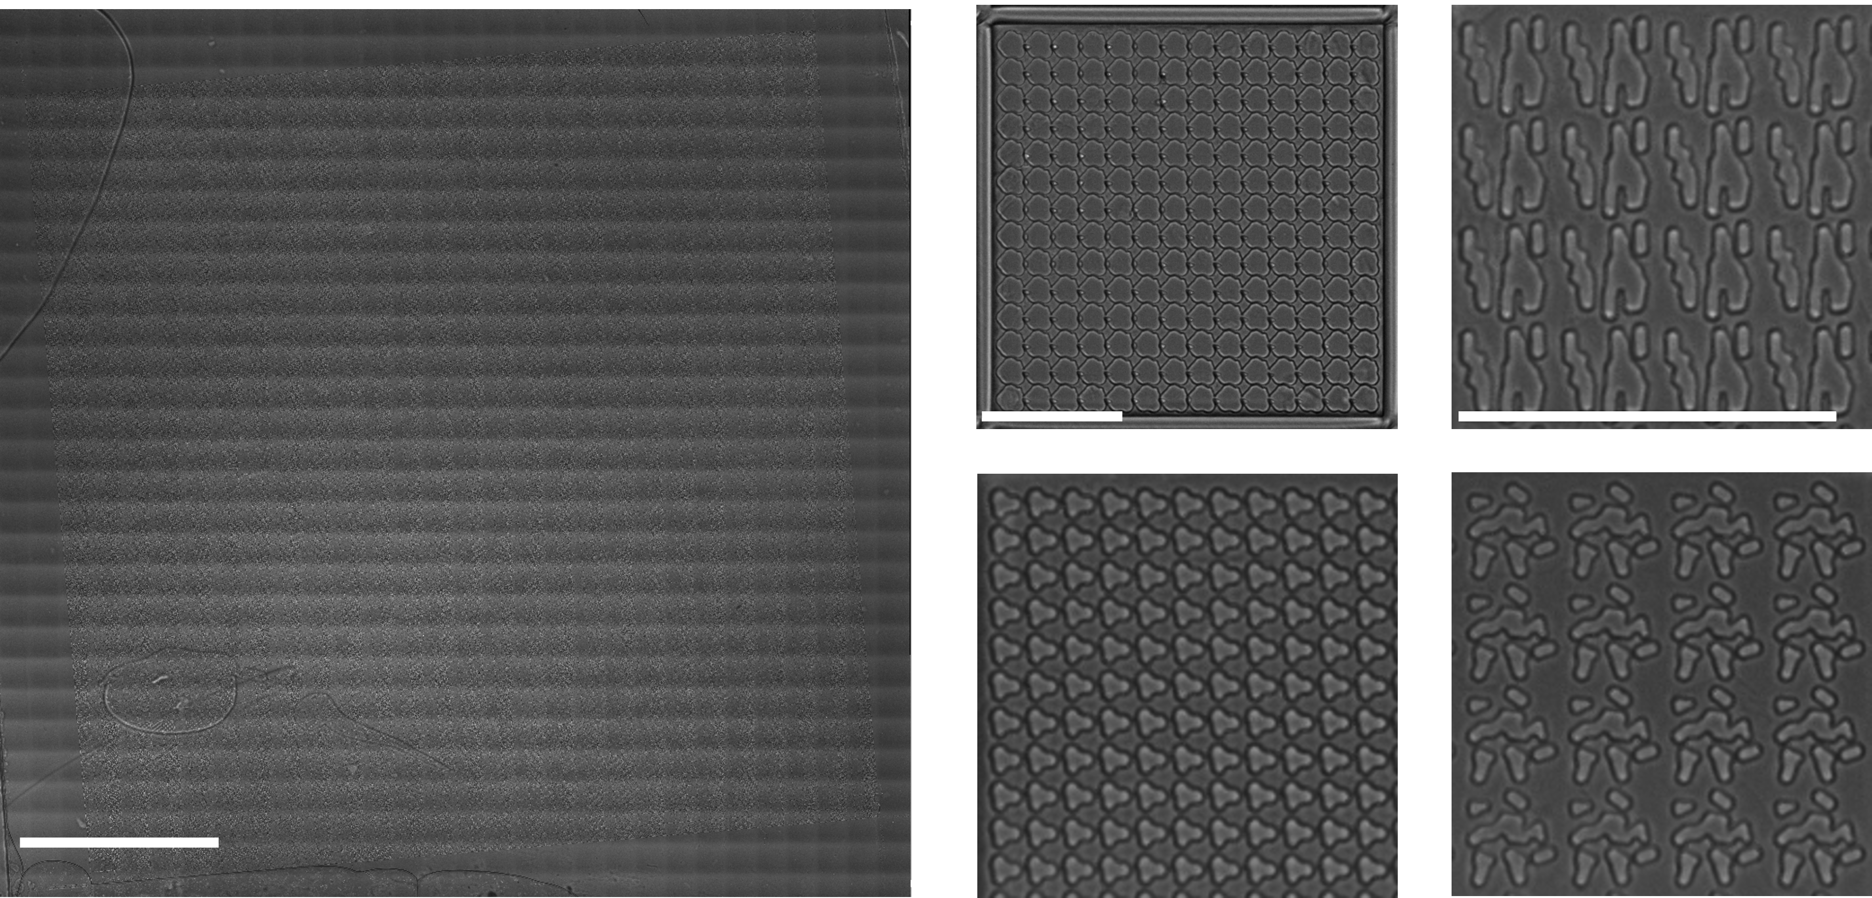
A
B
C1
C2
C3

Slide 3
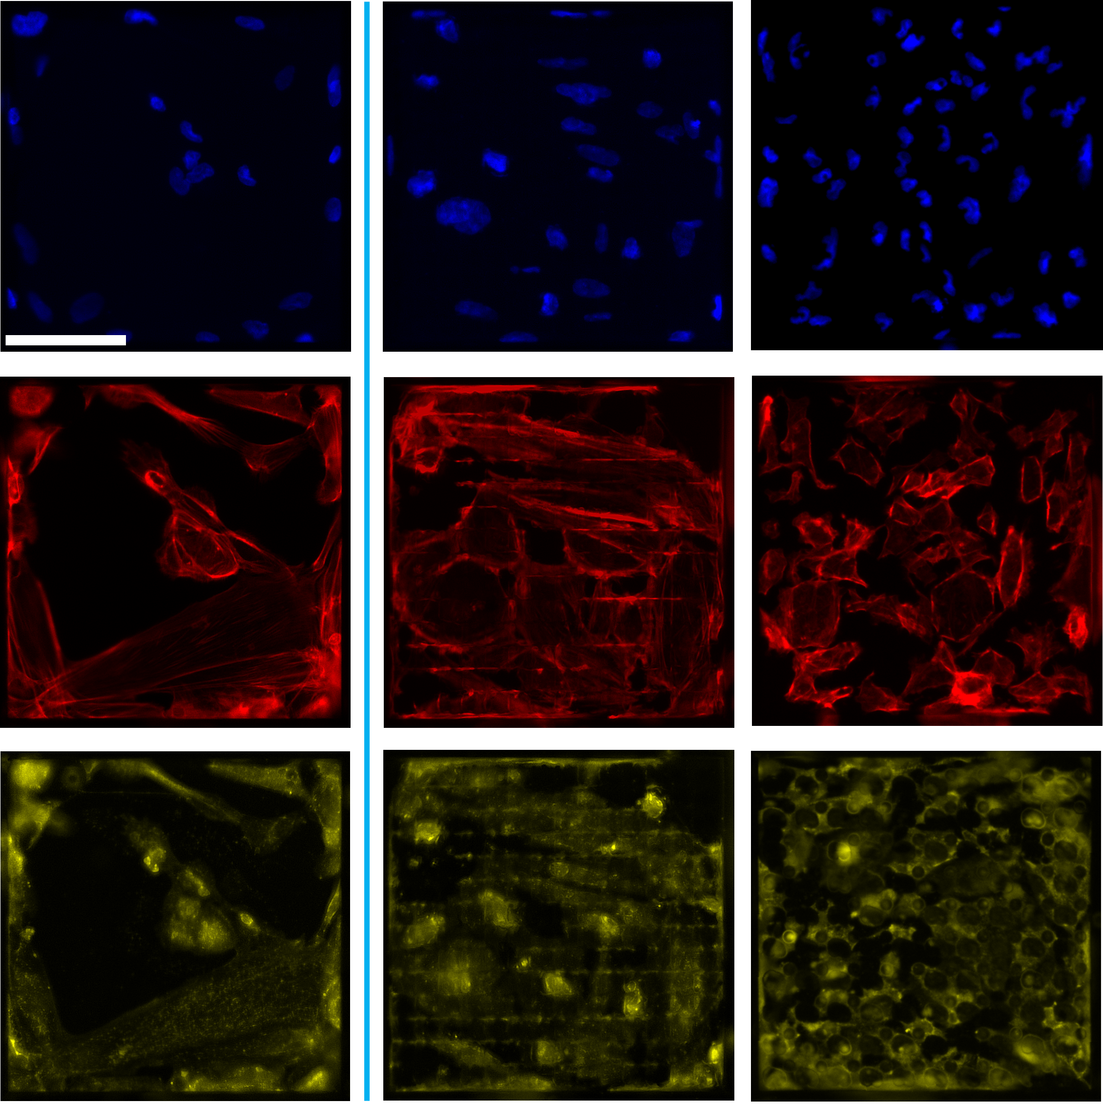
Flat
Topography 1
Topography 2
A
DAPI
B
Phalloidin
C
Nephrin

Slide 4
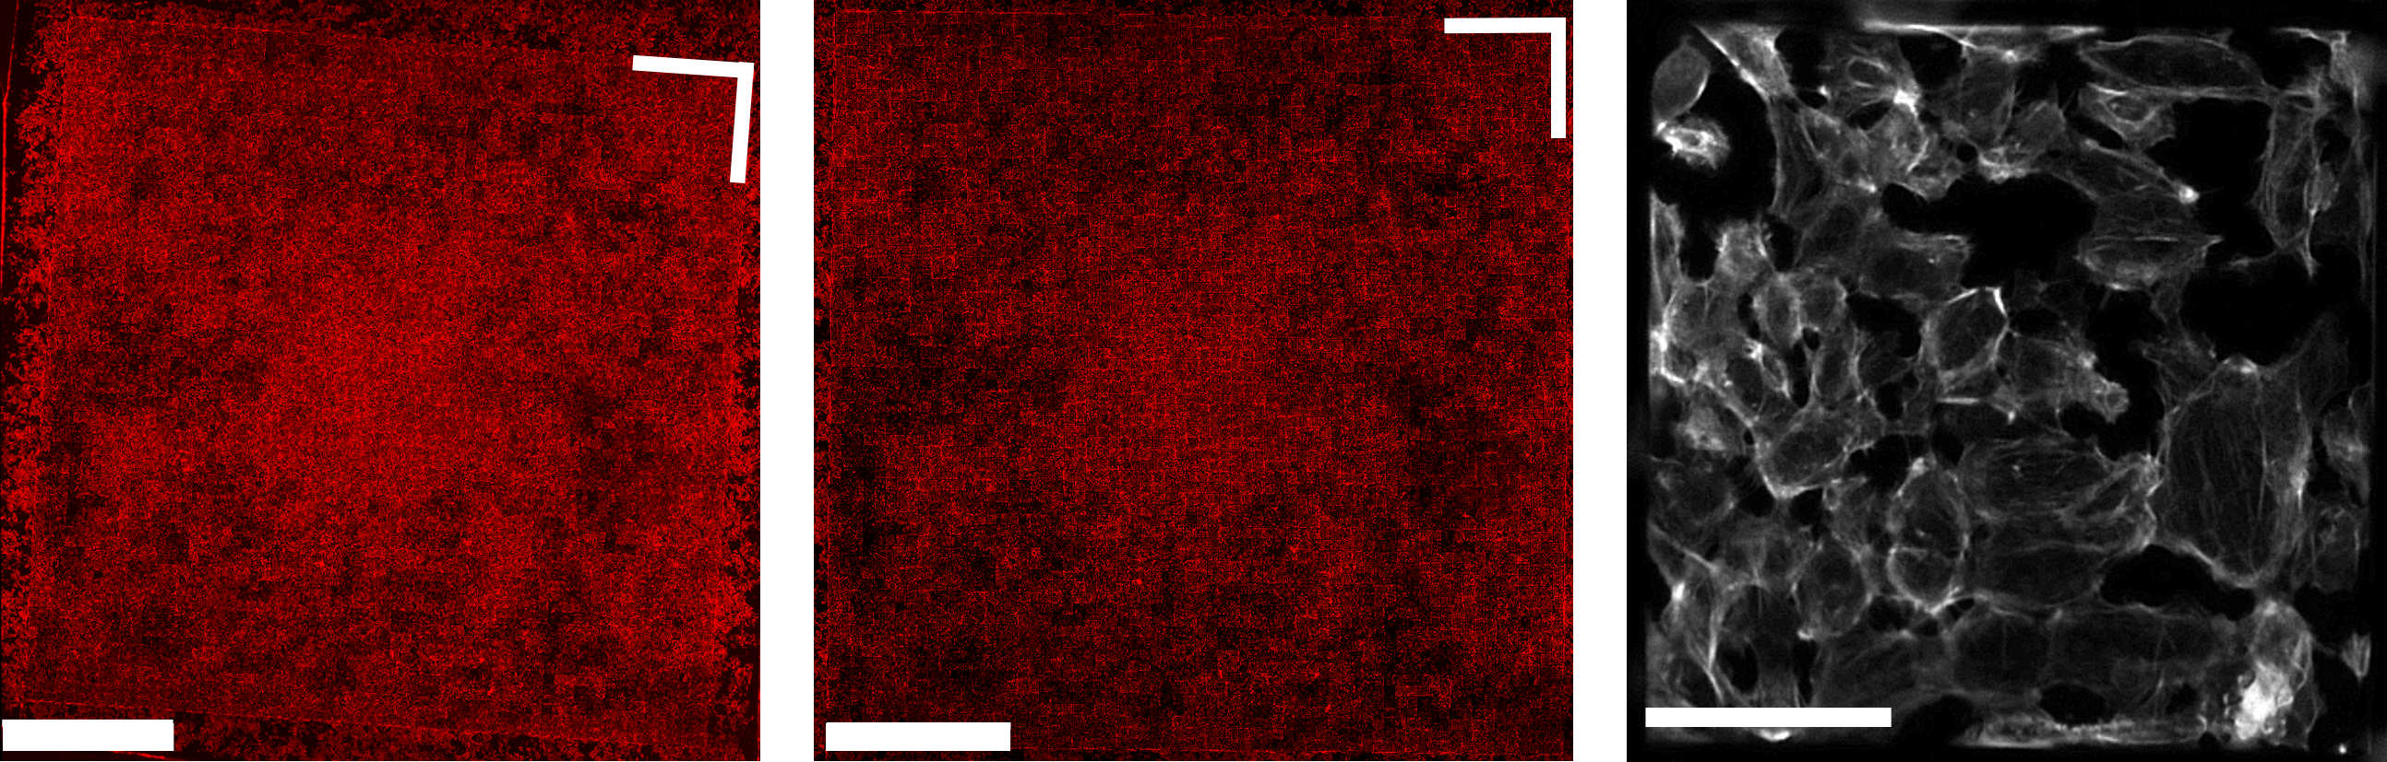
A
B
C

Slide 5
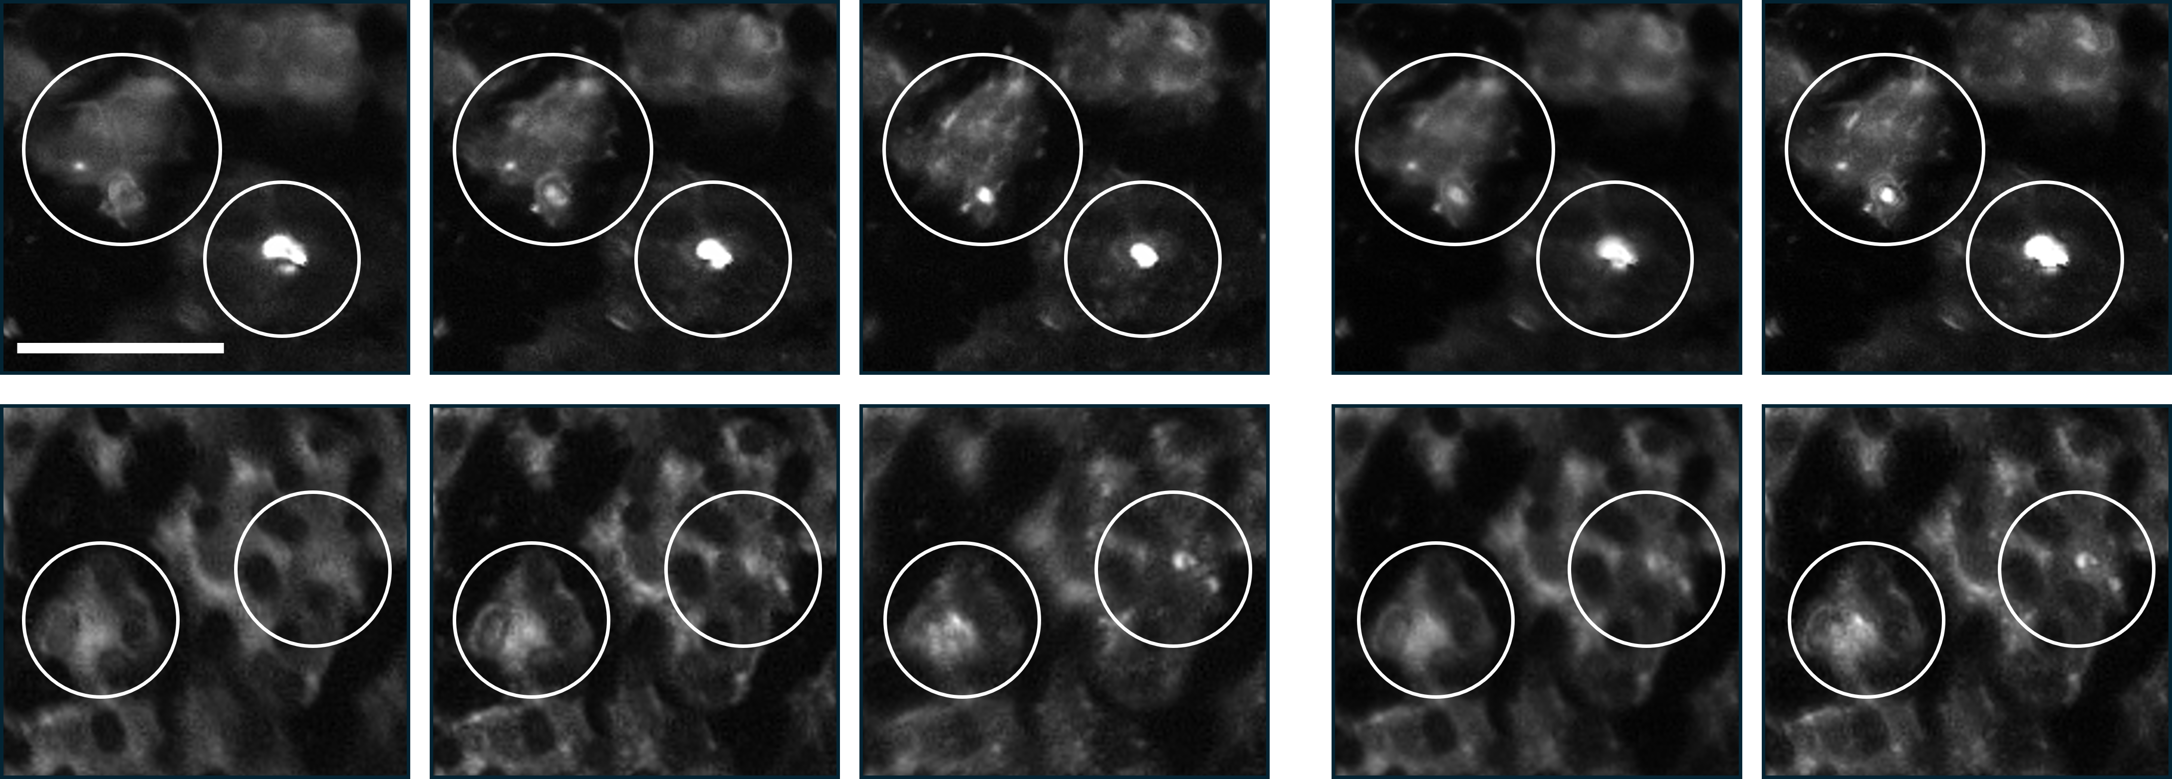
-4 µm plane
Autofocus plane
+4 µm plane
Average projection
Maximum projection (optimized)
Nephrin
Nephrin

Slide 6
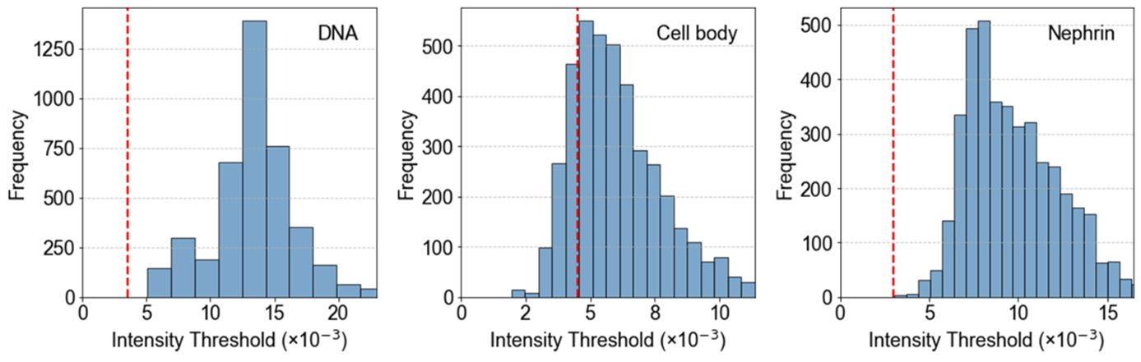

Slide 7
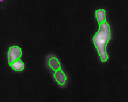
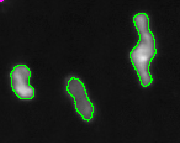
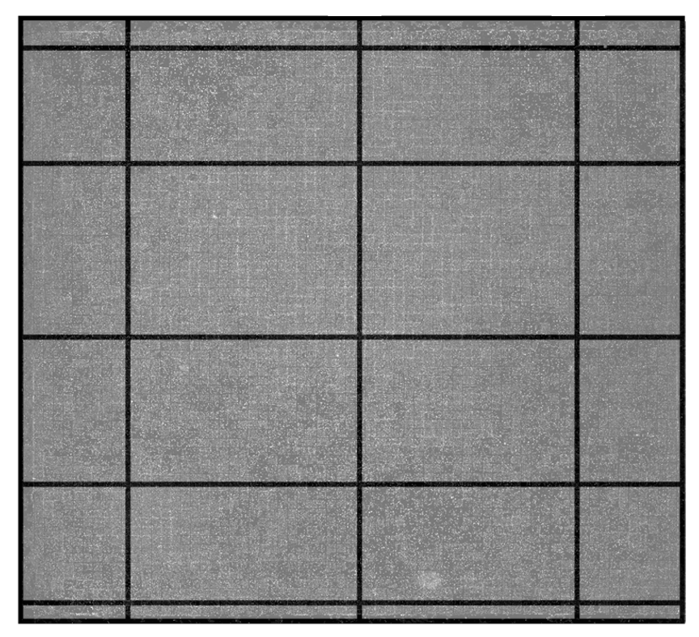
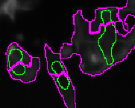
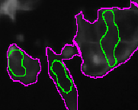
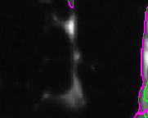
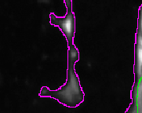
A
B
Optimized on a single chip
Optimized on a screen subset
66 columns
7
33
57
4
DAPI
15
66 rows
35
Phalloidin
50
64
Nephrin

Slide 8
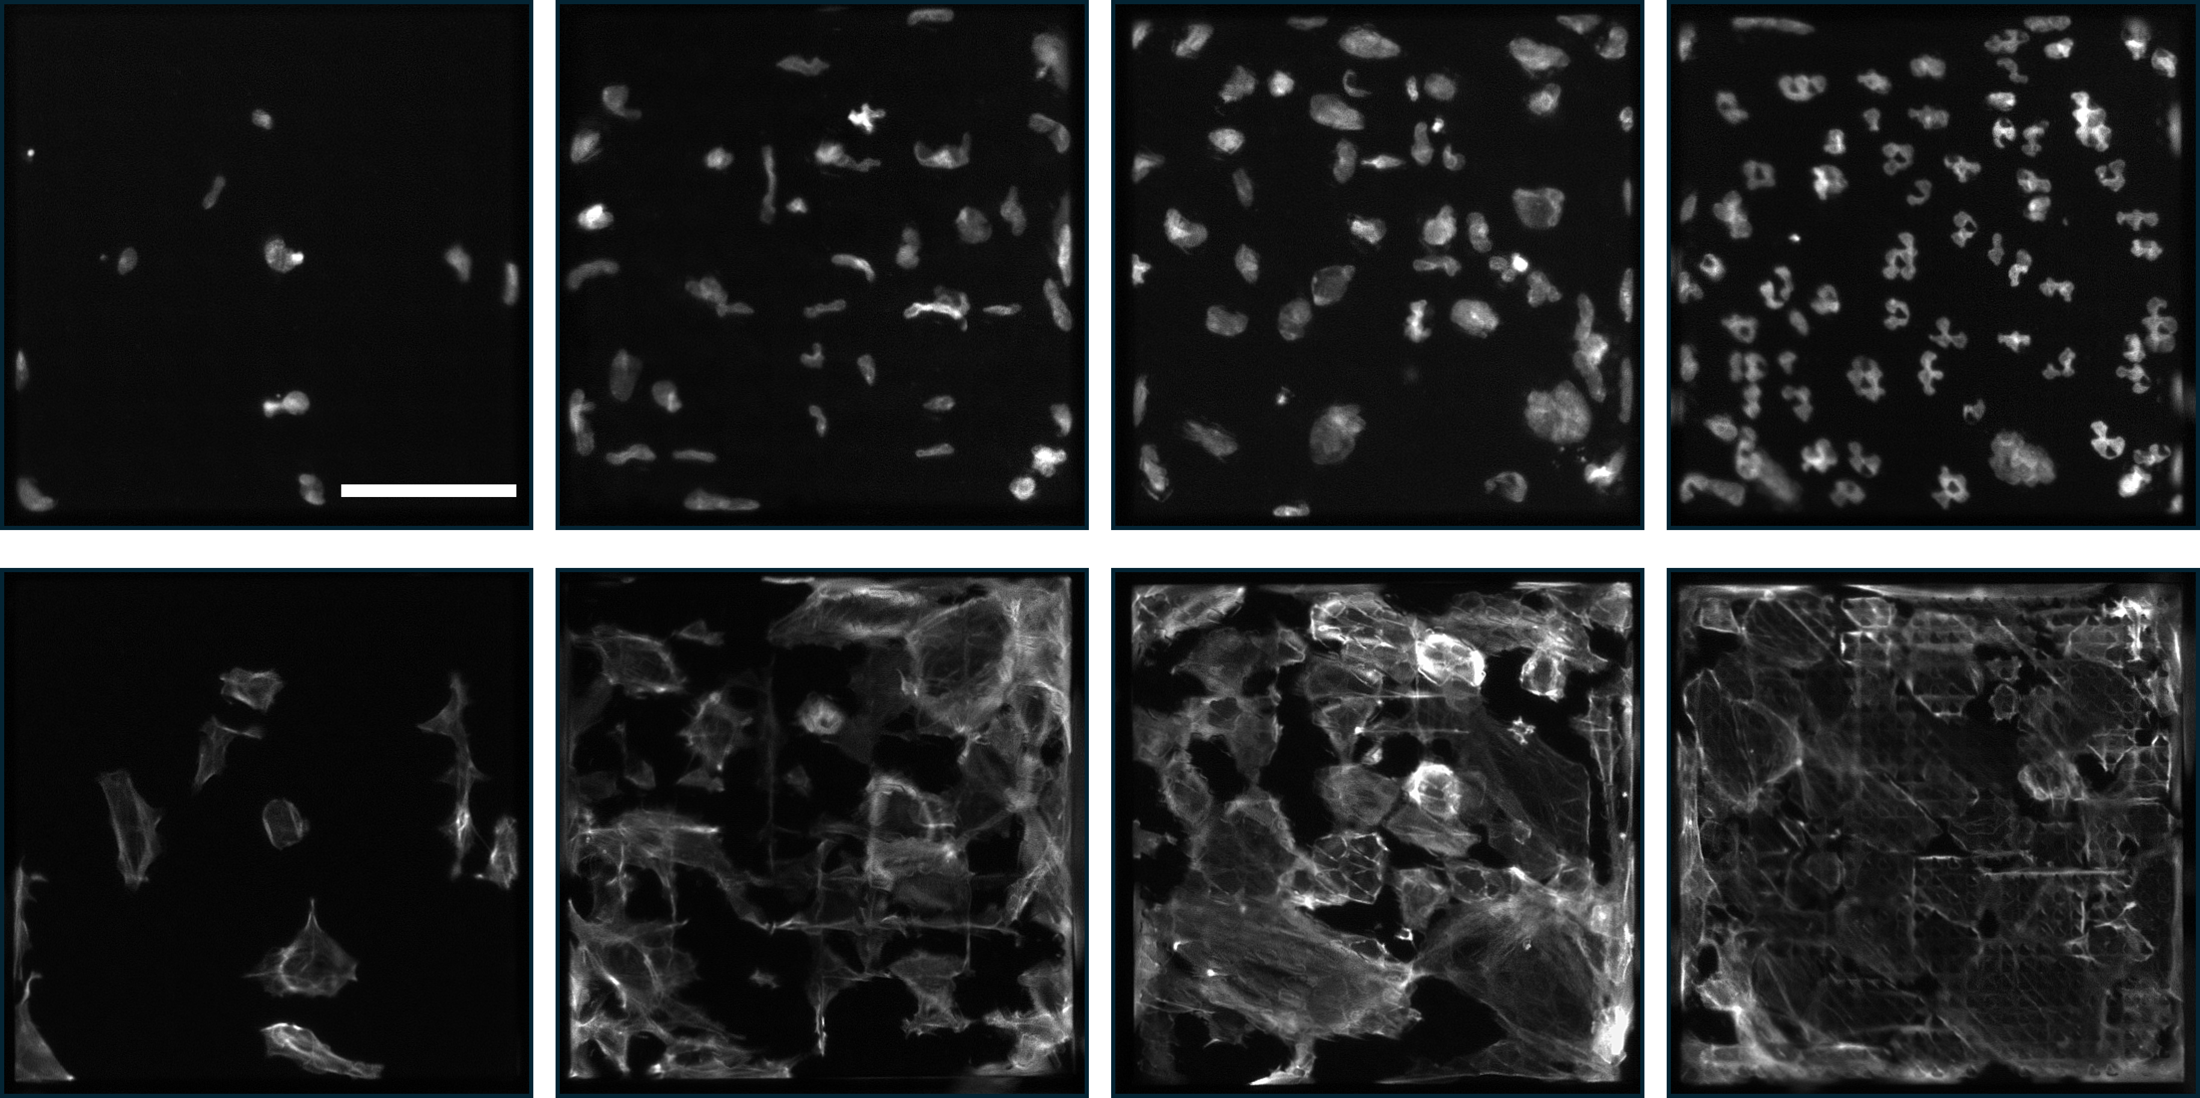
10
20
30
40
DAPI
Phalloidin

Slide 9
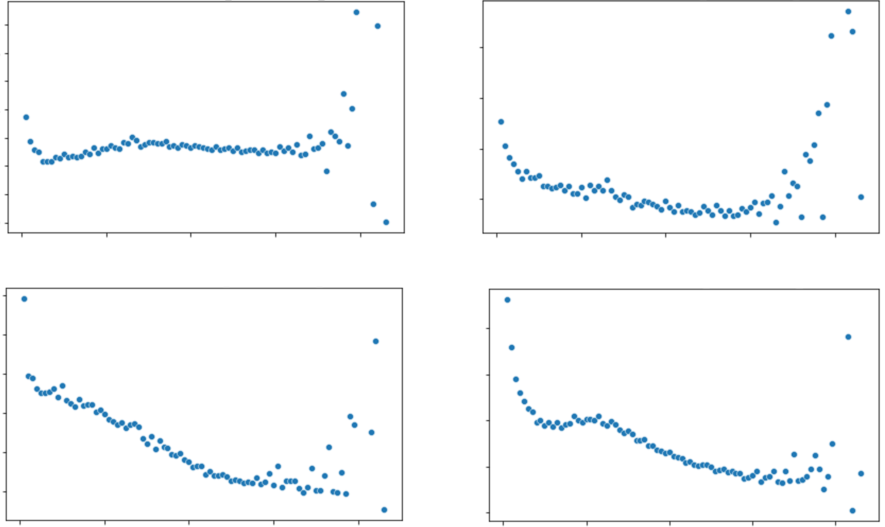
0.7
0.4
Nuclear
intensity
Nuclear
circularity
0.1
0.1
20
Cell count
80
20
Cell count
80
0.5
0.2
Nuclear
area
Cortical actin
0.05
0.1
20
Cell count
80
20
Cell count
80

Slide 10
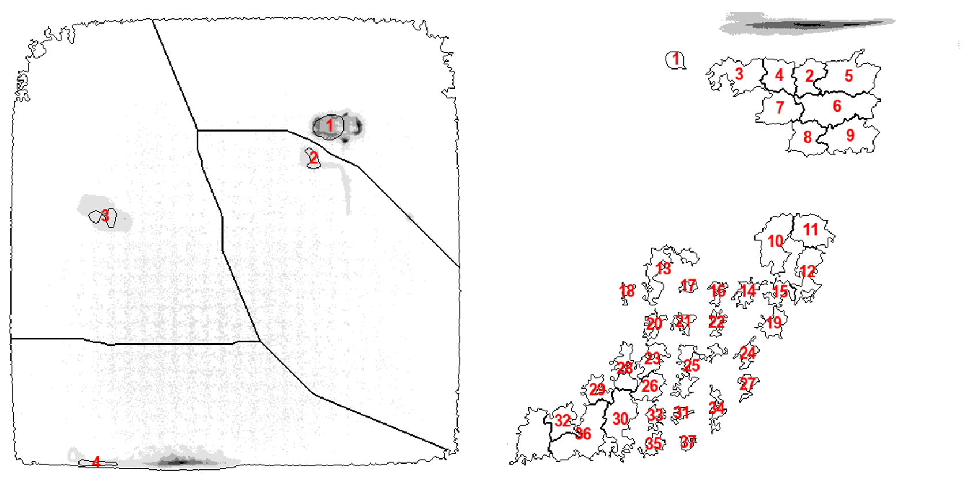
A
B
A
B

Slide 11
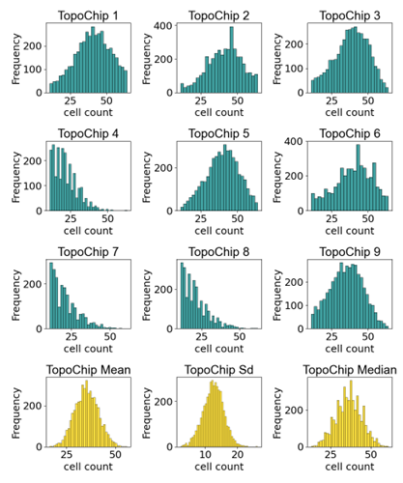
Cell count
Cell count
Cell count
Cell count
Cell count
Cell count
Cell count
Cell count
Cell count
Cell count
Cell count
Cell count

Slide 12
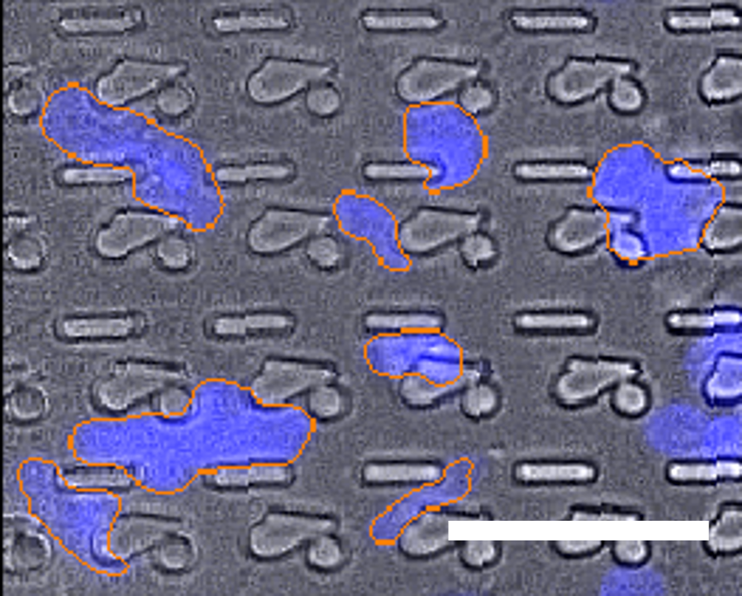
4
1
5
2
6
3
7

Slide 13
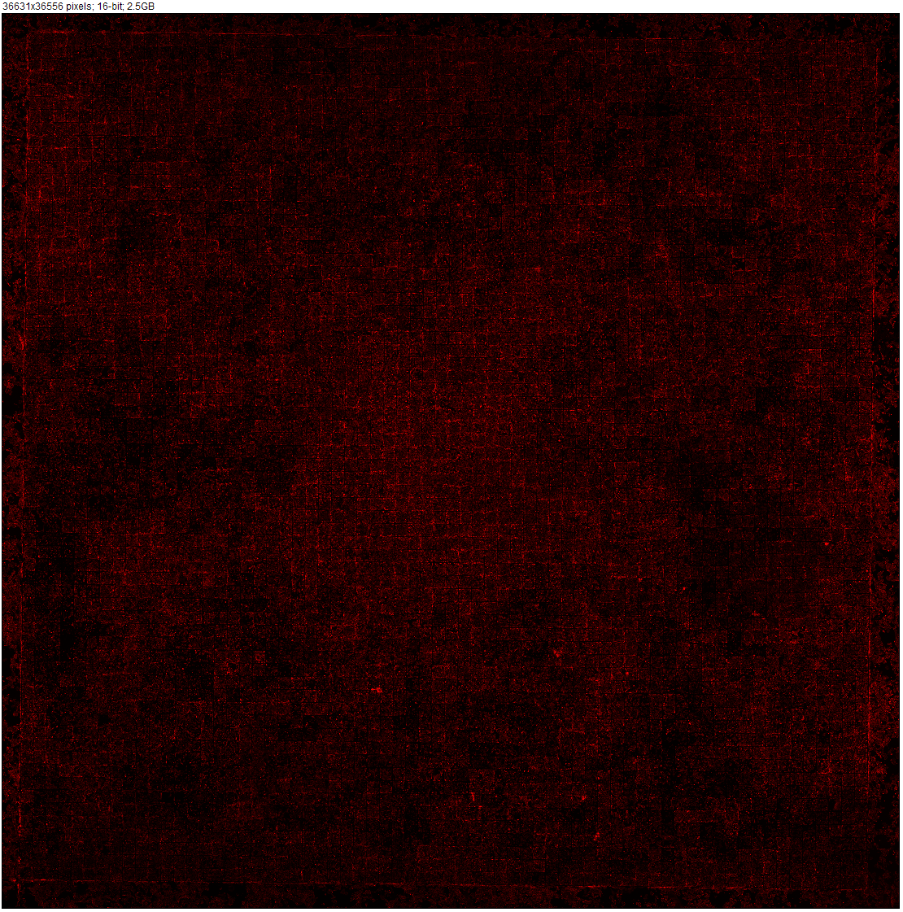
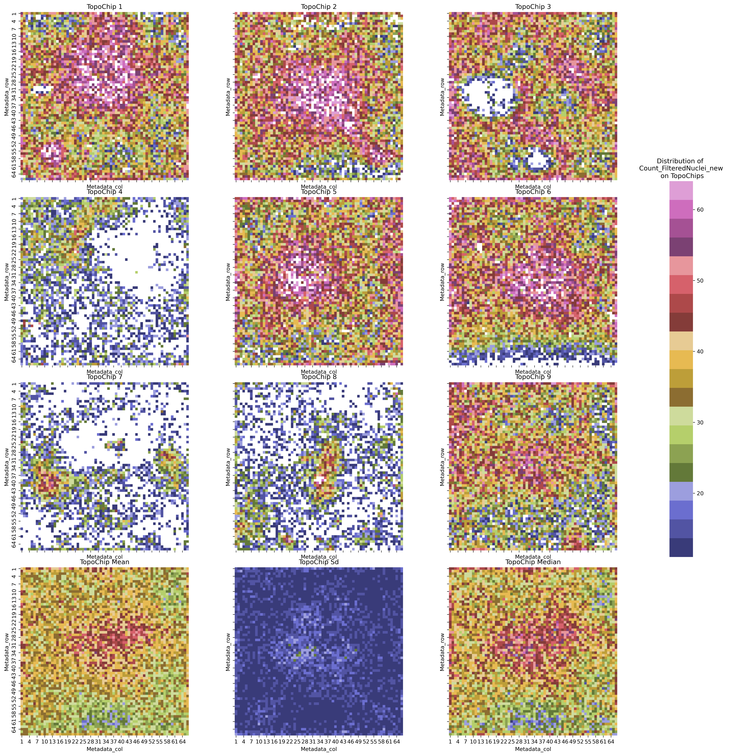
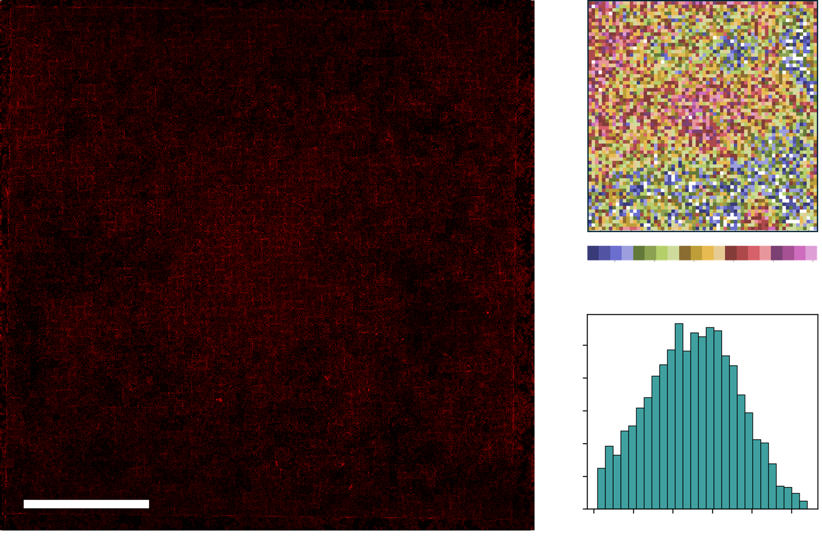
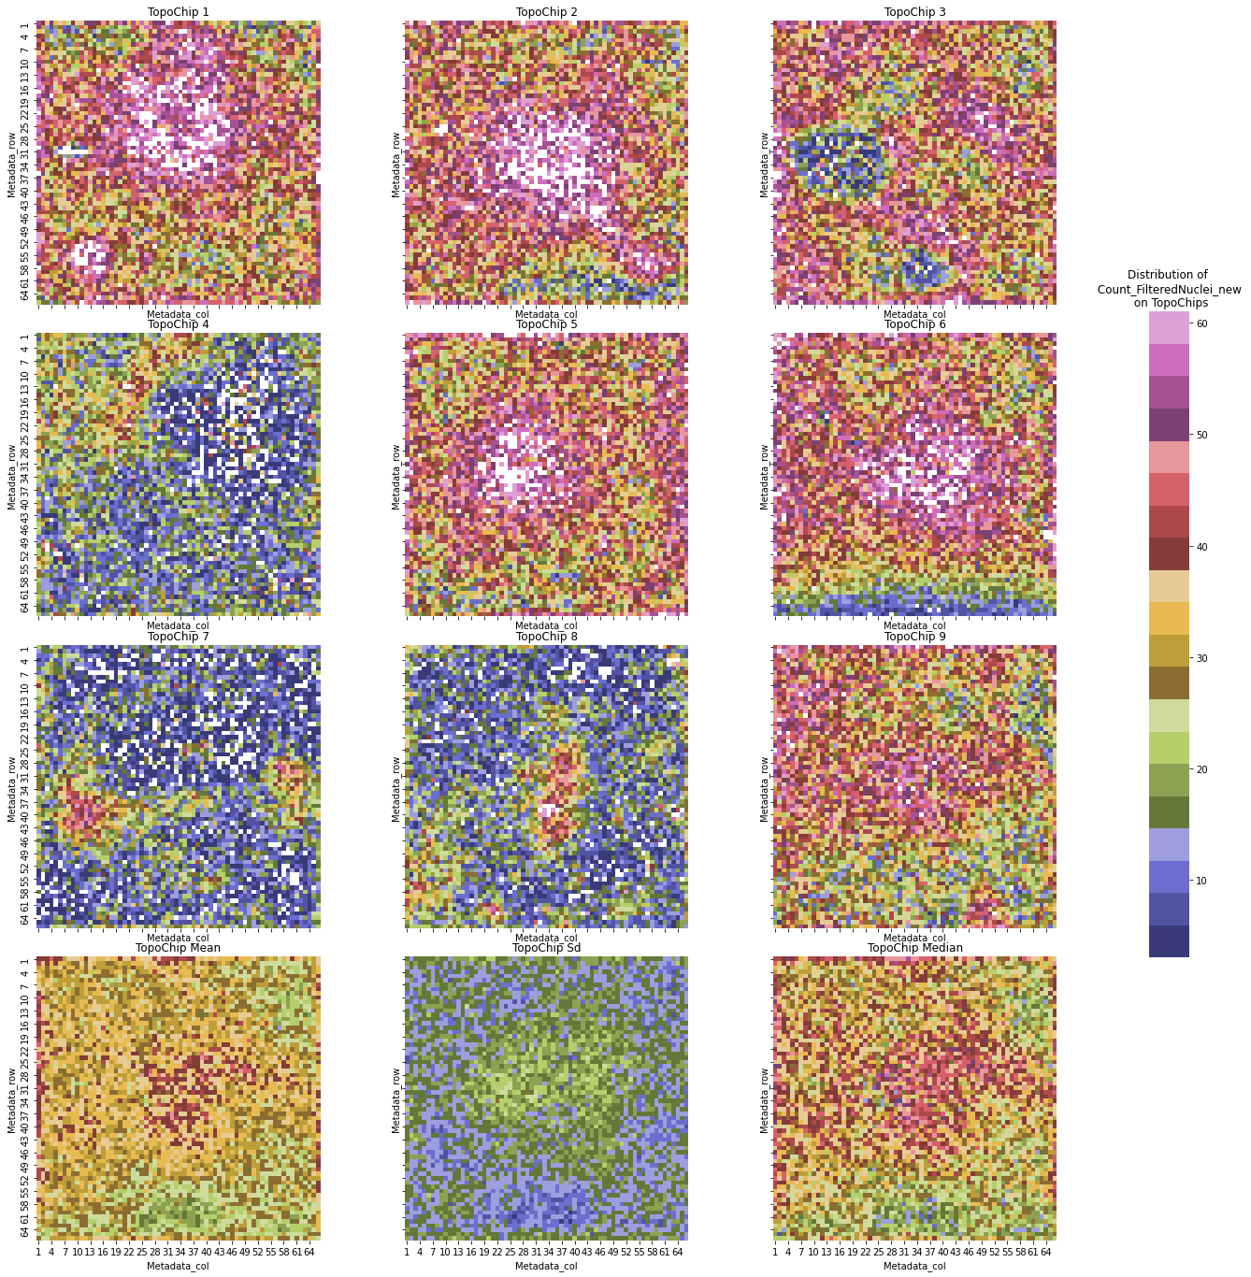
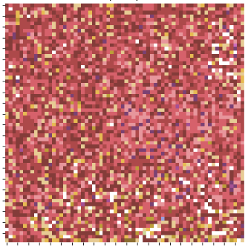
A
B
A
B
20
Cell count
60
20
Cell count
60
0.3
Nuclear circularity
0.9
C
C
20
Cell count
60

Slide 14
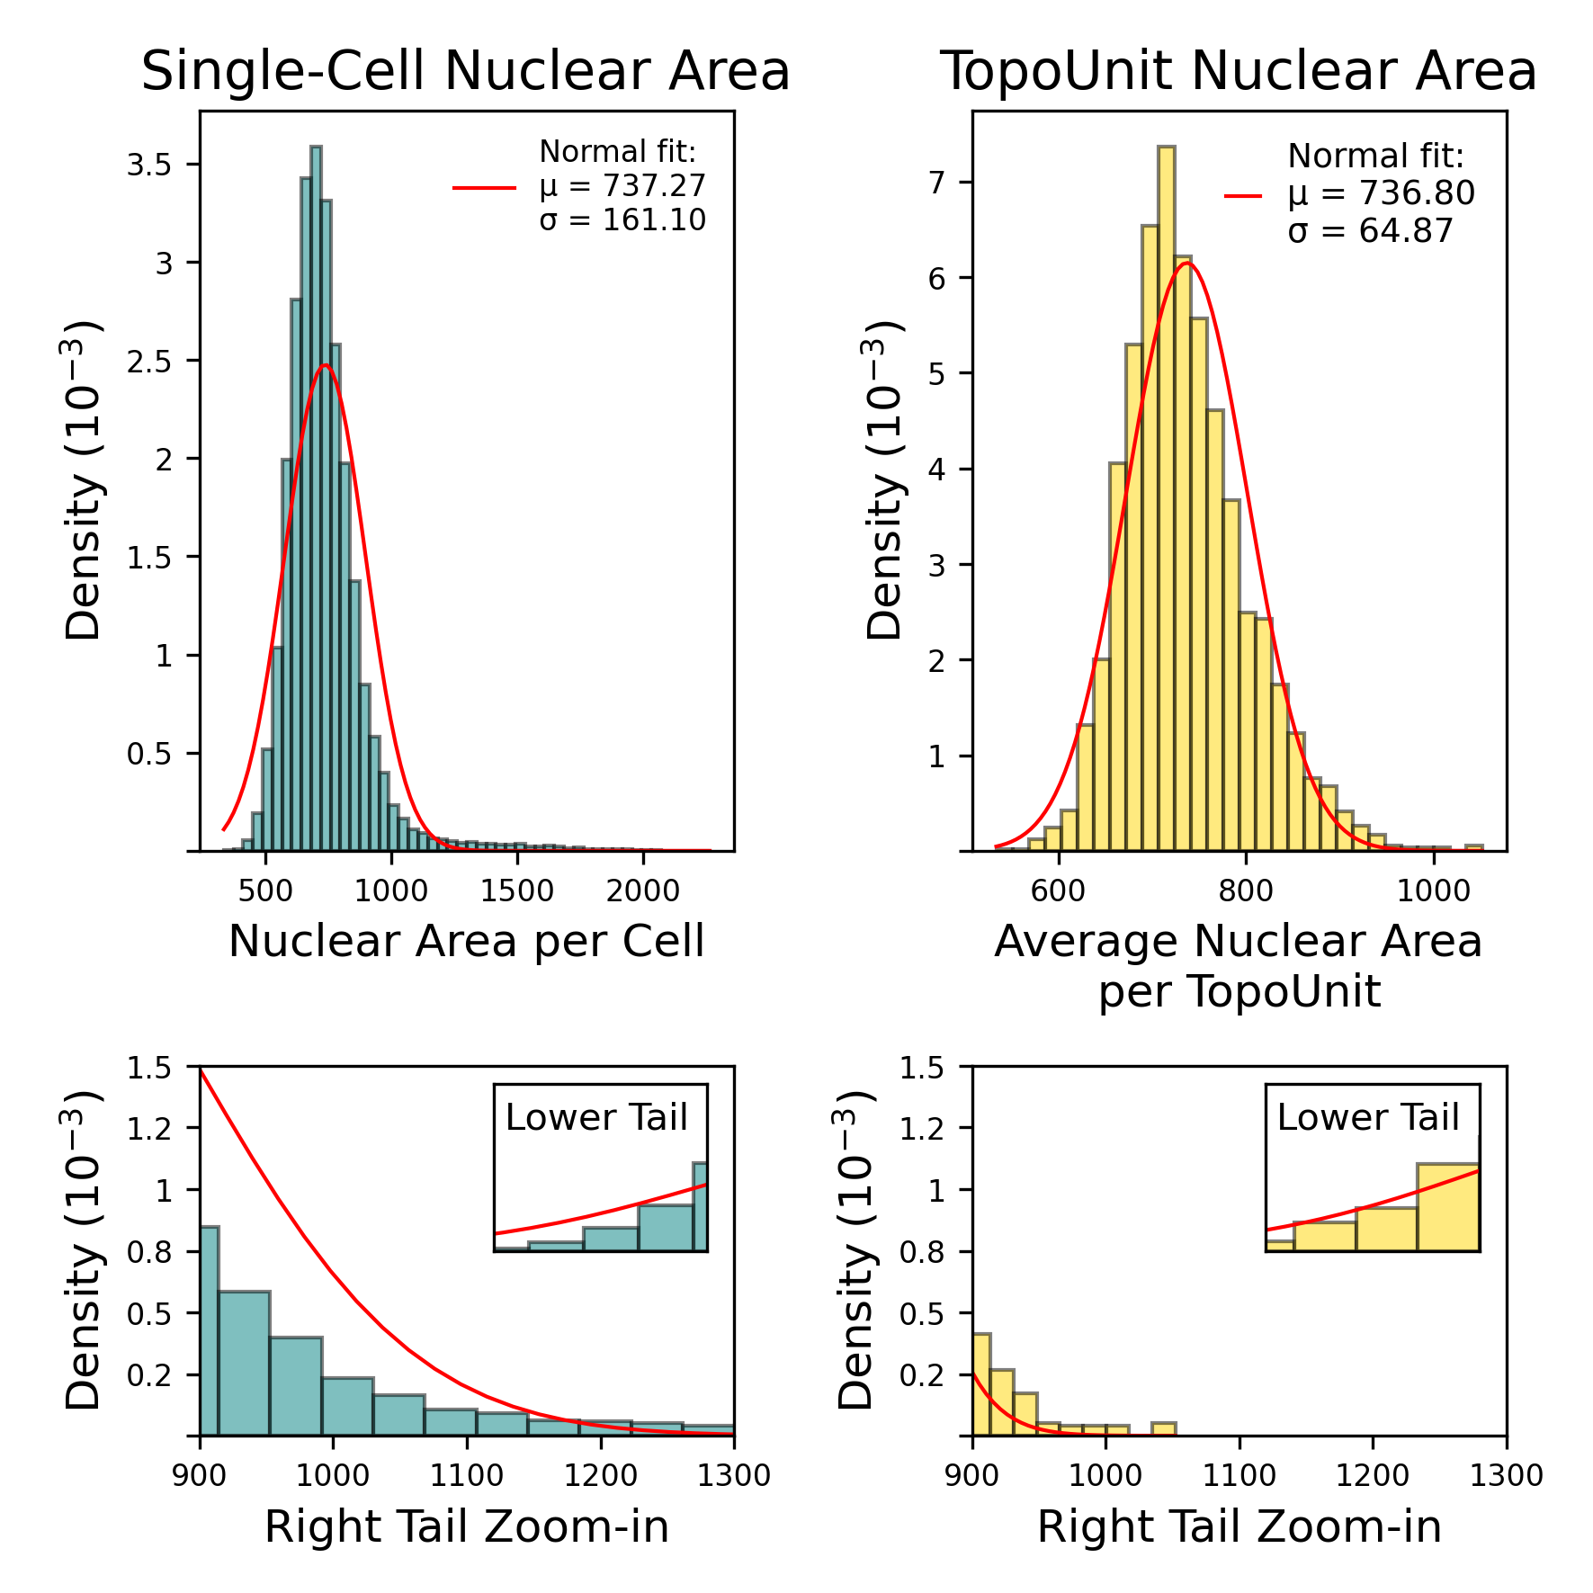
Normal fit
A
B
C
D

Slide 15
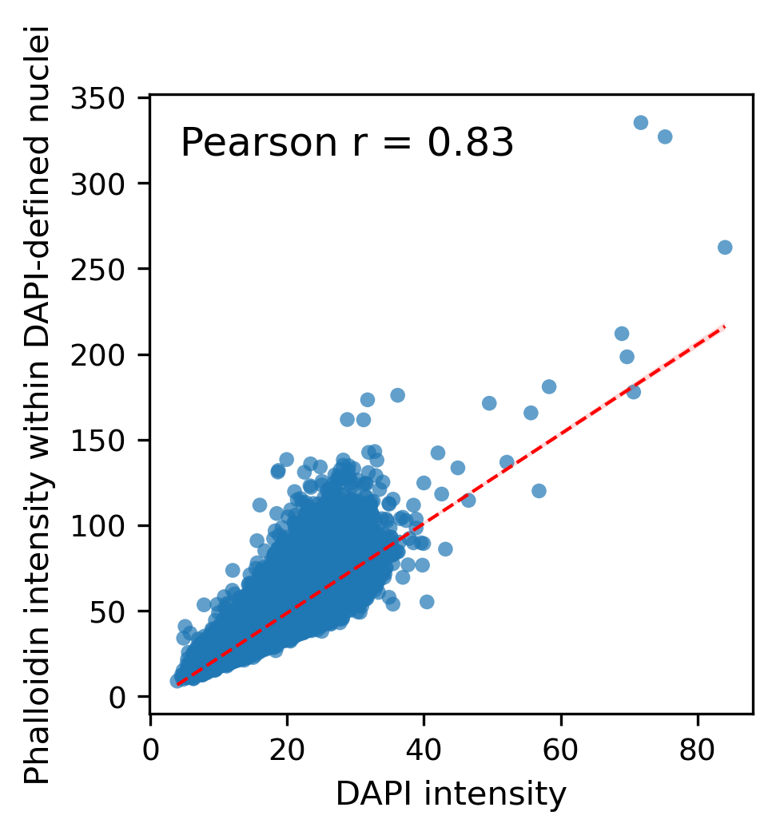

Slide 16
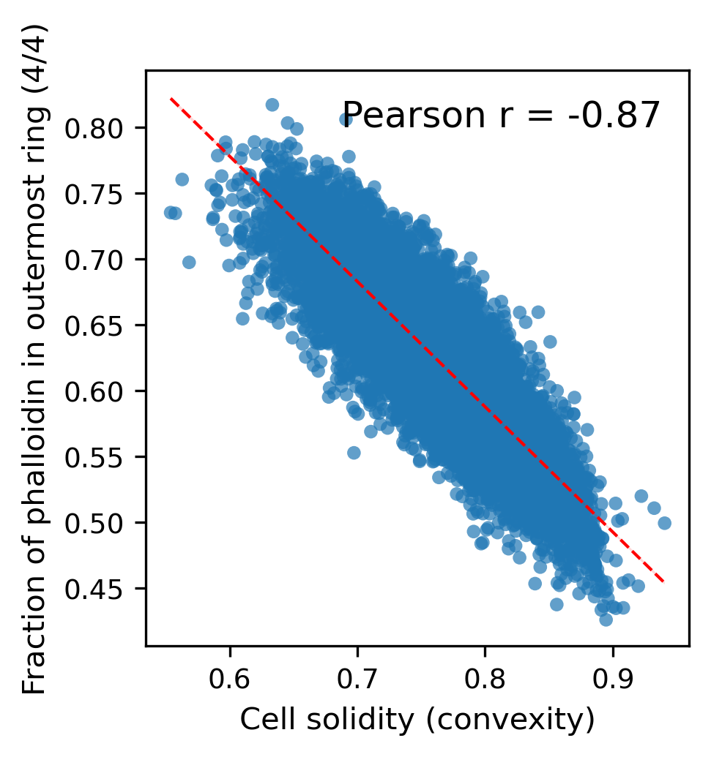

Slide 17
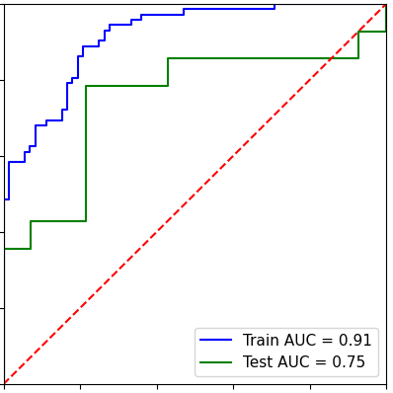
1.0
True Positive Rate
0.0
False Positive Rate
1.0

Slide 18
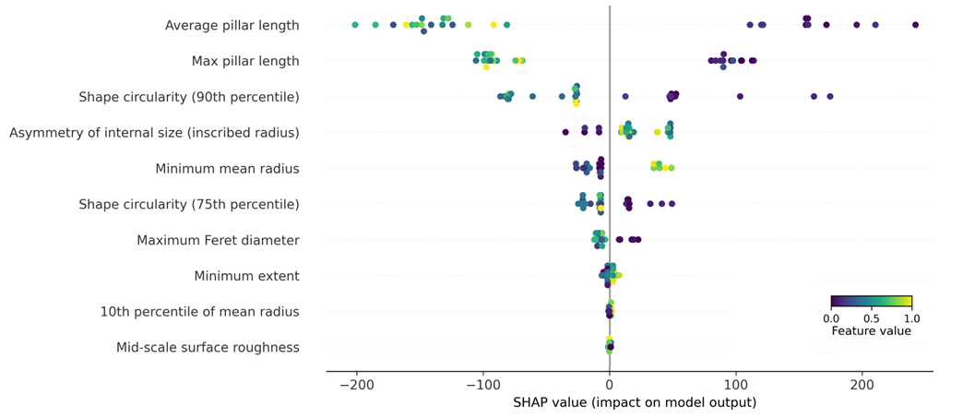
Average pillar length
Max pillar length
Shape circularity (90th percentile )
Asymmetry of internal size (inscribed radius)
Minimum mean radius
Shape circularity (75th percentile )
Maximum Feret diameter
Minimum extend
Feature value
Mean radius (10th percentile )
Mid-scale surface roughness
low
high
-200
-100
0
100
200
SHAP value impact on model output

